Slide 1
Figures and tables for (high level) Common Framework article

Slide 2
Next Gen Manufacturing in the Industry
 | N-1 | N Brx | Number of Columns | Virus inact. | Number of Columns | Number of Columns | Virus Filter | UFDF | GMP?
Amgen | ? | Perf | Single | Batch | Single | Single | Batch | Batch | Y
Sanofi | TBD | Perf | Multi | Both | Multi | Multi | Cont. | Cont. | Y
Novartis | Perf | Perf | Multi | Batch | Single | Single | Cont. | Cont. | Y
BMS | Perf | Batch | Multi | Batch | Single | Single | Batch | Batch | Y
Merck (MSD) | Perf | Perf | Multi | Batch | Multi | Multi | Cont. | Batch | Y
Merck (KgaA) | ? | Batch | Multi | Cont. | Multi | Multi | Batch | Batch | Y
Pfizer/BI | Perf | Perf | Multi | Cont. | Single | Single | Batch | Batch | N
Bayer | ? | Batch | Multi | Cont. | Multi | Multi | ? | ? | ?
Janssen | Perf | Batch | SIngle | Batch | Single | Single | Batch | Batch | Y
AstraZeneca | Perf | Perf | Multi | TBD | Single | Single | TBD | TBD | N

Slide 3
Common Framework for Equipment and Facility Design
Optional Lot Pool
Surge tank
In-line titration
Feeds
4x2kL Bioreactors
100L
Tank or PFR
??
ATF
Cell Retention
500L
Virus Inactivation
Polishing
Capture
ATF
In-line titration
In-line titration
120-500kg
??
Surge tank
Optional lot pool
SPTFF or
UF/DF
Polishing
VRF
Notes:
Need an intermediate pool
Need MCC if you don’t want ot have a surge tank
Surge tanks enable single column chromatography
Simplest with respect to equipment design and automation

Slide 4
Common Framework ICB capable of up to 500kg lot size or 8tons per year
1
2
4x500L &
4x2kL bioreactors
1
2
3
4
1
1
1
4
4
4
1
2
3
4
1
1
1
4
4
4
3
4
1
2
3
4
1
1
1
4
4
4
ProA
1
2
3
4
1
1
1
4
4
4
VI
16x5kL media hold
24x5kL buffer hold
AEX
Integrated Downstream
CEX
Single Use Plant Schematic for 500kg or greater batches for 22pcd cell lines in dynamic perfusion or 30pcd cell lines in steady state perfusion
VRF
UFDF
Notes:
3x solution: 500kg dose
1x solution:
1x & 2vvd:

Slide 5
Bioreactor Assumptions
Bioreactor 5
Bioreactor Size (L) | 500-2000
Number of bioreactors | 1-4
Avg cell density (million cells/mL) | 50-120
Qp (pg/cell/day) | 20-40
Permeate Perfusion Rate (bioreactor volumes/day, vvd) | 0.5-2 (1.5)
Lot (Batch) Duration (days) | 20
Number of concentrated media feeds | 1-5 (3)
Media Concentration Factor | 1x to 5x (20x, 12x, and 5x)
Cell Retention Systems for 2000L bioreactors
Number of ATF 10 for ATF setup | 4 per 2000L bioreactor
TFF modules in series for TFF setup | 4 per 2000 bioreactor
Filter changes per lot | 1 per bioreactor
Yield | 90%

Slide 6
Downstream Assumptions
Chromatography | Protein A | Flow Through | Bind/Elute
Capacity (g/L) | 30-60 (60 SCC, 73MCC) | 50-150 (100 SCC, 120 MCC) | 30-60 (40 SCC, 44 MCC)
Buffer Volume (1x) used (Column Volume, CV) | 16-22 (22) | 10-16 (16) | 10-20 (16)
Volume of solutions (column volumes) | 21 | 9 | 16
Number of solutions used | 7 | 4 | 4
Yield | 90% | 95% | 85%
Step | Yield
Cell Retention | 90%
Capture Chromatography | 90%
Virus Inactivation | 98%
Flow Through Chromatography | 95%
Bind and elution polishing step | 85%
Virus Filtration Yield | 95%
UFDF Yield | 95%
Numbers in parentheses are used in text as example

Slide 7
 | Number of Buffers | Wash volume (column volume or Diavolume) | Product Mass Index | Buffer Conc Factor | Buffer Concentrate Mass Index (kg buffer/kg BDS)
ProA | 7 | 21 | 534 | 5 | 107
VI | 2 | 0.1 | 15 | 1 | 15
AEX | 4 | 16 | 220 | 5 | 44
CEX | 5 | 17 | 521 | 5 | 104
VRF | 1 | 6 | 15 | 5 | 3
UFDF | 1 | 1 | 126 | 1 | 126
Total* | 14 | 59 | 1421 |  | 399
*The number of buffers does not include the VI/VRF buffers, as those will not go into large buffer tanks. The sanitization of UFDF is also not counted in this estimate. 400kg buffer/kg BDS equally divided among 14 buffers means each kg of BDS requires 29L of each buffer. A 140kg batch will require 14x5000L tanks for buffer storage

Slide 8
 | Cell Specific Productivity | Bioreactor Productivity | Product Mass Index for media concentrate (kg media/kg product) | Number of 2kL bioreactors required | Number of 5kL tanks needed for 140kg batch
Dynamic Perfusion | pg/cell/day | g/L/day
 | 10 | 1.2 | 641 | 4 | 17
 | 20 | 2.4 | 321 | 2 | 9
 | 30 | 3.6 | 214 | 2 | 6
 | 40 | 4.8 | 160 | 2 | 5
 | 50 | 6 | 128 | 1 | 4
Steady State Perfusion | 10 | 0.5 | 1538 | 11 | 44
 | 20 | 1 | 769 | 6 | 22
 | 30 | 1.5 | 513 | 4 | 15
 | 40 | 2 | 385 | 3 | 11
 | 50 | 2.5 | 308 | 3 | 9
Dynamic perfusion at 120M cells/mL average cell density
Steady State Perfusion at 50M cells/mL average cell density

Slide 9
Water Usage per day
 | Volume (L) | Days for Prep | Water/day (L)
Media prep | 80,000 | 20 | 4,000
Solution prep | 200,000 | 20 | 10,000
Dilution for media | 160,000 | 20 | 8,000
Dilution for solution | 500,000 | 20 | 25,000
 |  | Total | 47,000

Slide 10
TFF Design
Total permeate flow
1-2vvd
To bioreactor
0.5vvd
0.5vvd
TFF filter modules
50cm long
1vvd
0.5vvd
0.5vvd
From bioreactor
85 L/min
1.5” tubing
Swap out individual filters?
Confidential

Slide 11
TFF Design
Total permeate flow
1-2vvd
To bioreactor
0.5vvd
0.5vvd
TFF filter modules
50cm long
1vvd
0.5vvd
0.5vvd
From bioreactor
85 L/min
1.5” tubing
Swap out individual filters?
Confidential

Slide 12
TFF Design
Total permeate flow
1-2vvd
To bioreactor
TFF filter modules
50cm long
From bioreactor
85 L/min
1.5” tubing
Confidential

Slide 13
TFF Design
How long a filter can be gamma irradiated? Can we put 1.5” (or wider) flexible tubing between filter modules to allow them to fold over and fit into the irradiation device? Also, allow for shipping?
How can we get a small scale version of this design to test?
Flexible tubing
6” TC
Confidential

Slide 14
TFF Design
Total permeate flow
1-2vvd
From bioreactor
85 L/min
From bioreactor
85 L/min
From bioreactor
85 L/min
From bioreactor
85-170L/min
From bioreactor
85 L/min

Slide 15
Retentate Tank
Single pass concentration
Multi-stage in-line diafiltration
Single pass final concentration
Small UF for end-to-end daily concentration
Large system for batch DF

Slide 16
Final DS tank
Cont. stream from VRF
Conc 1 tank
DF tank
Small UF for end-to-end daily concentration
Large system for batch DF

Slide 17
Two Column Skid
In-line Conditioning
Load
Water
3
Solutions
4
Equil
Wash
Wash
Wash
Valve Manifold
Elute
Strip
Regen
1
2
Product
Notes:
CNC area
Functionally closed system
IoT parts
Self-validating
No more than 1m2 space
What kind of molecules?
Changeover time
Operator schedule
User Requirement Information Architecture

Slide 18
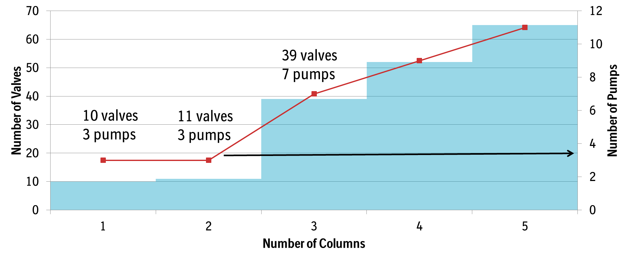
Skid complexity is low for one or two columns; significantly higher for >3
The Entry Level Version of NGM is Two Columns
Notes:
Calculate the number of instruments

Slide 19
Figures and tables for Design Basis for Common Framework

Slide 20
Design basis for ICB for 0.5-20kg/day
One-Column Retrofit
0.5kg-10kg/day
Two Column
0.5kg-20kg/day
mAb
Bi-specific
Fc-Fusion
Enzymes
rProtein
500-2kL Perfusion
Capture
Batch or Cont VI
Polishing 1
Polishing 2
Virus Filter
UFDF
ATF or TFF
Depth Filter
4-14m²
100-400LPM
4-14m²
100-400LPM
>500L surge
3L-20L
0.1 to 5LPM
2L-20L
0.1 to 5LPM
7m² changed daily
7m² changed daily
1L-5L
0.1 to 1LPM
0.3L-10L
0.1 to 1LPM
Gene therapy (oos)
Plasmid production
Cont. Transfection
Virus bioreactor
Purification
1L-10L
0.1 to 3LPM
0.5L-20L
0.1 to 5LPM
0.3-5m²
1 to 10LPM
0.3-5m²
1 to 10LPM
5-13m²
Cross Flow 30-80LPM
5-13m²
Cross Flow 30-80LPM

Slide 21
Skid Pump Design and column size range for 100-2000L BRX for perfusion or fed batch
Fed batch with 10g/L titer
Water
0.5-10L/min
Equil
Wash
Wash
0.4 L Column
At 10g/L load
1 cycles per day:
Minimum: 4g/day
Use 1x buffers and no water
Wash
0.1-2L/min
Valve Manifold
Elute
Strip
40L Column at as much as 60g/L capacity
16 cycles per day: Maximum 38kg/day
Regen
Load
0.1-10L/min
In batch dynamic range: 160
Batch-to-batch dynamic range: 8000
Notes:
CNC area
Functionally closed system
IoT parts
Self-validating
No more than 1m2 space
What kind of molecules?
Changeover time
Operator schedule
User Requirement Information Architecture

Slide 22
Two Column Skid
In-line Conditioning
Load
0.1-10 L/min
Water
0.5-10 L/min
3
Buffers
0.1-2 L/min
4
Equil
Wash
Wash
Wash
Valve Manifold
Elute
Strip
Regen
1
2
UV: 0.1 & 1mm pathlength
Scan 230-320nm
Product
Additional sensors on inlets can allow real-time modelling to assure step operated as intended
Notes:
CNC area
Functionally closed system
IoT parts
Self-validating
No more than 1m2 space
What kind of molecules?
Changeover time
Operator schedule
User Requirement Information Architecture

Slide 23
Can a one column skid mimic an overloaded Twin?
Load
0.1-10L/min
Water
0.5-10L/min
Equil
Wash
Wash
Wash
Valve Manifold
Elute
Strip
Regen
0.1-2 L/min
Overload Flow through Surge Tank
Product
Notes:
CNC area
Functionally closed system
IoT parts
Self-validating
No more than 1m2 space
What kind of molecules?
Changeover time
Operator schedule
User Requirement Information Architecture

Slide 24


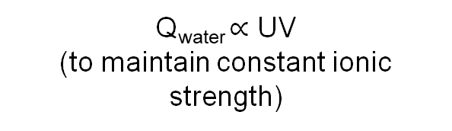
Virus Inactivation Skid for Batch or Continuous
From ProA Column
UV
Acid
0.05-1L/min
Q_{acid} $∝\text{UV}$
Q_{base} $∝\text{UV}$
Plug Flow Reactor or Tank
Water (for PFR)
UV
Q_{water} $∝\text{UV}$
(to maintain constant ionic strength)
Base
0.1-2L/min
Product
pH
24

Slide 25
PFR Characteristics
 | Flow Rate Range | Volume | Efficiency (Vreq/ Videal) | Plant Volume Efficiency (V liquid/ Vsystem) | Description of RTD
CFI | 5-20ml/min |  | 130% | 1%
JIG | 50-200 mil/min |  | 120% | 30%
JIG | 500ml/Min |  | 120% | 30%
Packed Bed Reactor | Any flow |  | 110% | 30%
Static mixers
Coiled tubing

Slide 26
Bioreactor Assumptions
Bioreactor
Bioreactor Size (L) | 500-2000 (2000)
Number of bioreactors | 1-4
Avg cell density (million cells/mL) | 50-150 (150)
Qp (pg/cell/day) | 20-60 (40)
Permeate Perfusion Rate (bioreactor volumes/day, vvd) | 1.5
Batch Duration | 14-30 (20)
Number of concentrated media feeds | 1-5 (3)
Media Concentration Factor | 1-20x (3x, 12x, 20x)
Cell Retention Systems for 2000L bioreactors
ATF 10 retentate flow rate (L/min) | 85
Number of ATF 10 for ATF setup | 4 per bioreactor
Number of TFF for TFF setup
Filter changes per lot | 1 per bioreactor
TFF membrane capacity (L/m²) | 1000
Yield | 90%
TFF length 41.5 | 41.5
TFF modules in series | 4
TFF Retentate Shear Rate (s⁻¹) | 2000

Slide 27
Downstream Assumptions
Chromatography | Protein A | Flow Through | Bind/Elute
Capacity (g/L) | 30-60 (60) | 50-150 (100) | 30-60 (40)
Buffer Volume (1x) used (Column Volume, CV) | 16-22 (22) | 10-16 (16) | 10-20 (16)
Elution Volume collected (CV) | 1.5-3 (2) | 0.2-0.5 (0.5) | 1.0-1.5 (1.5)
Yield | 90% | 95% | 85%
Virus Filtration
Capacity (L/m2) | 700-1400 (1000)
Flux (LMH) | 100
Yield | 95%
UFDF
Membrane Capacity (g/m2) | 800-1500 (1000)
Yield | 95%
Cross Flow (LMH) | 300-500 (300)
Concentration 1 Flux (LMH) | 30-60 (50)
# Diavolumes | 6
Final DS Conc Target (g/L) | 100

